Slide 1
BIYA GALLERY · THE THIRD ART
يس
Ya Sin
T H E S A C R E D L E T T E R S
SURAH YASEEN (36) · EIGHTY-THREE VERSES · MECCAN
A commissioned folio cycle - framed verse by verse, one verse one artwork
THE SACRED LETTERS EDITION · 2026 · IN PRODUCTION

Slide 2
BIYA GALLERY
PART 01
Contents
The Sacred Letters Edition
The Chapter
03
The sacred letters, facts of the surah, ten movements, anchor verses
PART 02
The Commission
08
One surah. Eighty-three
verses. Eighty-three
frames - verse by verse,
movement by movement.
Concept, design system, production pipeline, status of 83 frames
PART 03
The Verses
13
The full collection - 83 folio plates, one verse each, verified against the codex
PART 04
The Plan
97
BIYA GALLERY · ART & CRAFT · LAHORE
Timeline, acquisition, exhibition, next steps
BIYA GALLERY · ART & CRAFT
Original art, Thread Art, poetry and craft from Lahore
COLLECTION · SERVICES · POETRY

Slide 3
PART 01 · 03 / 103
The Chapter
Yaseen - the heart of the Qur'an: its letters, its structure, its ten movements
BIYA GALLERY · ART & CRAFT
Original art, Thread Art, poetry and craft from Lahore
COLLECTION · SERVICES · POETRY

Slide 4
THE CHAPTER · I.1
The Sacred Letters
The chapter opens with two letters: Ya Sin. As with the other lettered openings of the Qur'an, they are an address - a sign before the message, the oath that follows (“By the wise Qur'an”) hanging on them.
Readers have called them the alphabet of the book itself: a reminder that the very letters we read are a created sign, and that the words they carry came down from the Mighty, the Merciful.
The tradition names this surah the heart of the Qur'an - no heart to a body, no heart to a book.
THE OPENING, IN ARABIC
يس
Ya Sin. - By the wise Qur'an.
Surah Yaseen 36:1-2
BIYA GALLERY · ART & CRAFT
Original art, Thread Art, poetry and craft from Lahore
COLLECTION · SERVICES · POETRY

Slide 5
THE CHAPTER · I.2
Facts of the Surah
POSITION
LETTERS
36th surah of the Qur'an
Ya Sin - two lettered openings
REVELATION
VERSES
Meccan
83 (aya)
JUZ
MANZIL
22 (vv. 1-27) and 23 (vv. 28-83)
5
MUSHAF PAGES
CHARACTER
440-445 (Uthmani codex)
Called the heart of the Qur'an in tradition
Verses and pagination verified against the Uthmani codex (alquran.cloud), retrieved 19 September 2026.
BIYA GALLERY · ART & CRAFT
Original art, Thread Art, poetry and craft from Lahore
COLLECTION · SERVICES · POETRY

Slide 6
THE CHAPTER · I.3
Ten Movements
01
vv. 01–05
02
vv. 06–12
THE SACRED LETTERS
THE HEEDLESS, THE REMINDER
Ya Sin - the wise Qur'an, the sent messenger on a straight path
Yokes and veils; only the Reminder's followers are warned
03
vv. 13–19
04
vv. 20–27
THE CITY AND ITS MESSAGERS
THE MAN OF THE CITY
Two, then three; the people's mockery and omen of ill
The runner who believes, and enters paradise honoured
05
vv. 28–32
06
vv. 33–40
ONE SHOUT, AND ALL ARE BROUGHT
SIGNS IN EARTH, SUN, MOON
The city is done; every generation returns before Us
Dead earth revived, the pairs, night and day, the orbits
07
vv. 41–44
08
vv. 45–54
THE LADEN SHIP
THE COMING HOUR
Offspring borne on ships; mercy for a while
The shout, the trumpet, the graves, no soul wronged
09
vv. 55–68
10
vv. 69–83
TWO GATHERINGS
THE REMINDER AND ITS CLOSING
Paradise's peace; the guilty's fire; the witnessing limbs
Not poetry; cattle; the bones; Be! and it is; the dominion
BIYA GALLERY · ART & CRAFT
Original art, Thread Art, poetry and craft from Lahore
COLLECTION · SERVICES · POETRY

Slide 7
THE CHAPTER · I.4
Verses That Anchor the Collection
VERSE 36:82 · Be! and it is.
VERSE 36:20 · The man from the city
إِنَّمَا أَمْرُهُۥٓ إِذَا أَرَادَ شَيْـًۭٔا أَن يَقُولَ لَهُۥ كُن فَيَكُونُ
وَجَآءَ مِنْ أَقْصَا ٱلْمَدِينَةِ رَجُلٌۭ يَسْعَىٰ قَالَ يَٰقَوْمِ ٱتَّبِعُوا۟ ٱلْمُرْسَلِينَ
"His command, when He intendeth a thing, is only that He saith unto it: Be! and it is."
"There came from the uttermost part of the city a man running: O my people, follow those who have been sent!"
VERSE 36:58 · Peace - a word from the Lord
VERSE 36:36 · He created the pairs
سَلَٰمٌۭ قَوْلًۭا مِّن رَّبٍّۢ رَّحِيمٍۢ
سُبْحَٰنَ ٱلَّذِى خَلَقَ ٱلْأَزْوَٰجَ كُلَّهَا مِمَّا تُنۢبِتُ ٱلْأَرْضُ وَمِنْ أَنفُسِهِمْ وَمِمَّا لَا يَعْلَمُونَ
"The word from a Merciful Lord is: Peace!"
"Glory be to Him Who created all the pairs, of the earth's growth, and of themselves, and of that which they know not!"
BIYA GALLERY · ART & CRAFT
Original art, Thread Art, poetry and craft from Lahore
COLLECTION · SERVICES · POETRY

Slide 8
PART 02 · 08 / 103
The Commission
Eighty-three frames, one verse each - how the collection is made and where it stands
BIYA GALLERY · ART & CRAFT
Original art, Thread Art, poetry and craft from Lahore
COLLECTION · SERVICES · POETRY

Slide 9
THE COMMISSION · II.1
The Concept
One verse, one frame.
Surah Yaseen has eighty-three verses; the commission has eighty-three folios. Each folio carries the verse in Uthmani script, its Pickthall rendering, and a commissioned artwork made for that verse alone - Third Art, the gallery's thread-and-frame practice.
The surah's own architecture sets the collection's order: ten movements, read in the mushaf's sequence, from the sacred letters to the dominion of all things.
Folio format: 1613 x 1314 px working master, printed 1.5x for gallery (2420 x 1971).
YASEEN 42 / 83
Of the Like
Whereon they ride.
THE ARTWORK
made for the verse
وَخَلَقْنَا لَهُم مِّن مِّثْلِهِۦ مَا يَرْكَبُونَ
36:42 · J. 23
BIYA GALLERY · ART & CRAFT
Original art, Thread Art, poetry and craft from Lahore
COLLECTION · SERVICES · POETRY

Slide 10
THE COMMISSION · II.2
The Design System
EVERGREEN
0E1F18
DEEP
0A1712
CREAM
F4EFE3
PAPER
EAE2CF
GOLD
B98A2E
LT. GOLD
D4AF5E
ESPRESSO
241B12
SAGE
9AA79B
TYPE · Playfair Display (display, gold italic accents) · Georgia (body 10-13) · Jost (letter-spaced micro-caps) · Simplified Arabic (Uthmani script)
Display - The Sacred Letters
Italic accent - verse by verse
Body - Every folio is quoted in full, in both the codex text and the Pickthall rendering, so the collection stands as a readable surah.
Micro-caps - THE THIRD ART
Arabic - the codex, verbatim
Frames - hard gold edge on cream paper; evergreen panel carries the text.
BIYA GALLERY · ART & CRAFT
Original art, Thread Art, poetry and craft from Lahore
COLLECTION · SERVICES · POETRY

Slide 11
THE COMMISSION · II.3
The Production Pipeline
01
02
03
04
05
VERSE
CALLIGRAPHY
THREAD ART
FINISH & FRAME
RECORD
Uthmani text and Pickthall rendering verified against the codex
→
The ayah set in the frame, Uthmani script
→
Panel executed in the Third Art thread practice, made for the verse
→
Gold-edge frame on cream paper, gallery finish
→
Photographed, polished, and saved at 1x and 1.5x print masters
The pipeline is the same as the 71-folio Rahman collection: each verse is a self-contained production, and the collection advances in batches of ten movements.
BIYA GALLERY · ART & CRAFT
Original art, Thread Art, poetry and craft from Lahore
COLLECTION · SERVICES · POETRY

Slide 12
THE COMMISSION · II.4
Status - 83 Frames
0 of 83 completed · all 83 frames reserved, sequenced, and verse-verified · production begins with Movement 01
01
02
03
04
05
06
07
08
09
10
11
12
13
14
15
16
17
IN PLAN
IN PLAN
IN PLAN
IN PLAN
IN PLAN
IN PLAN
IN PLAN
IN PLAN
IN PLAN
IN PLAN
IN PLAN
IN PLAN
IN PLAN
IN PLAN
IN PLAN
IN PLAN
IN PLAN
18
19
20
21
22
23
24
25
26
27
28
29
30
31
32
33
34
IN PLAN
IN PLAN
IN PLAN
IN PLAN
IN PLAN
IN PLAN
IN PLAN
IN PLAN
IN PLAN
IN PLAN
IN PLAN
IN PLAN
IN PLAN
IN PLAN
IN PLAN
IN PLAN
IN PLAN
35
36
37
38
39
40
41
42
43
44
45
46
47
48
49
50
51
IN PLAN
IN PLAN
IN PLAN
IN PLAN
IN PLAN
IN PLAN
IN PLAN
IN PLAN
IN PLAN
IN PLAN
IN PLAN
IN PLAN
IN PLAN
IN PLAN
IN PLAN
IN PLAN
IN PLAN
52
53
54
55
56
57
58
59
60
61
62
63
64
65
66
67
68
IN PLAN
IN PLAN
IN PLAN
IN PLAN
IN PLAN
IN PLAN
IN PLAN
IN PLAN
IN PLAN
IN PLAN
IN PLAN
IN PLAN
IN PLAN
IN PLAN
IN PLAN
IN PLAN
IN PLAN
69
70
71
72
73
74
75
76
77
78
79
80
81
82
83
IN PLAN
IN PLAN
IN PLAN
IN PLAN
IN PLAN
IN PLAN
IN PLAN
IN PLAN
IN PLAN
IN PLAN
IN PLAN
IN PLAN
IN PLAN
IN PLAN
IN PLAN
Grid reads in surah order, 17 per row. Movement boundaries: 05 · 12 · 19 · 27 · 32 · 40 · 44 · 54 · 68 · 83.
BIYA GALLERY · ART & CRAFT
Original art, Thread Art, poetry and craft from Lahore
COLLECTION · SERVICES · POETRY

Slide 13
PART 03 · 13 / 103
The Verses
The full collection - eighty-three folio plates, one verse each, in the order of the mushaf
BIYA GALLERY · ART & CRAFT
Original art, Thread Art, poetry and craft from Lahore
COLLECTION · SERVICES · POETRY

Slide 14
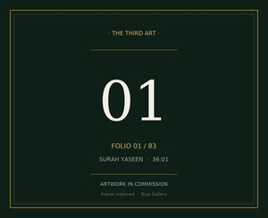
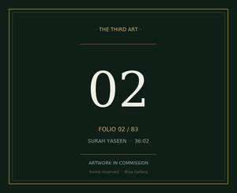
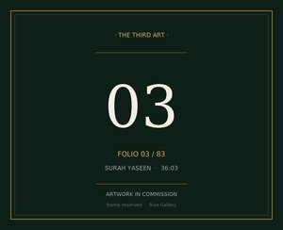
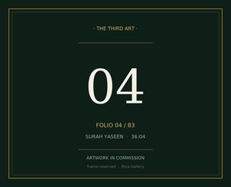
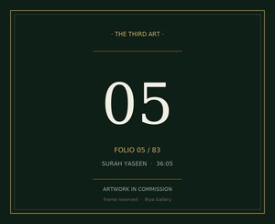
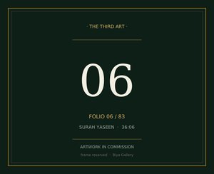
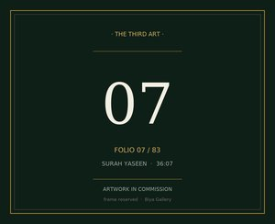
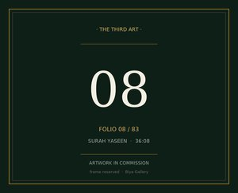
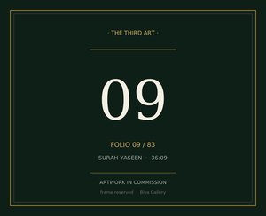
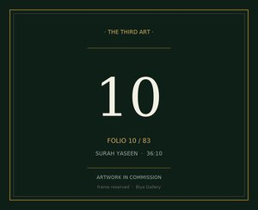
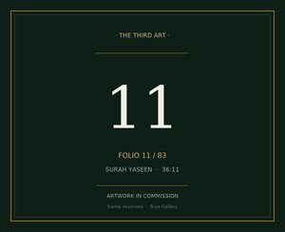
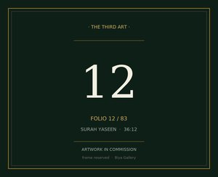
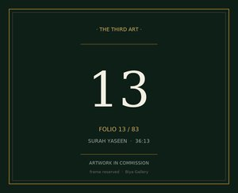
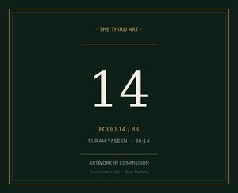
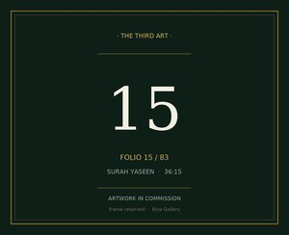
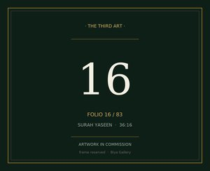
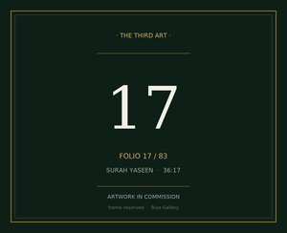

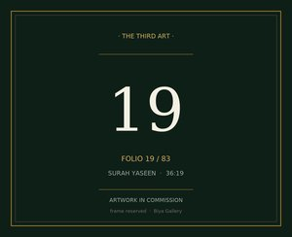
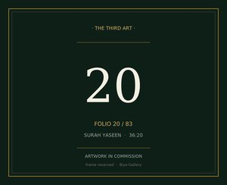
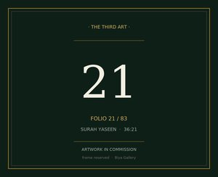
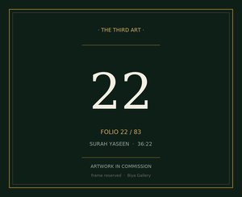
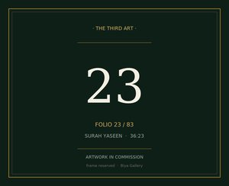
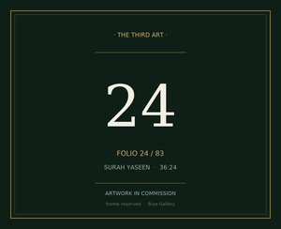
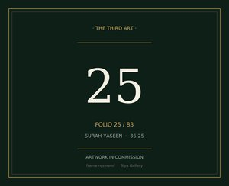
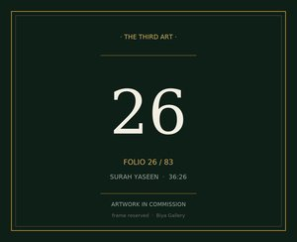


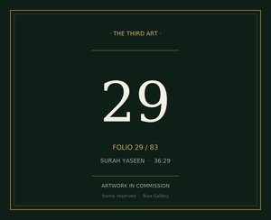
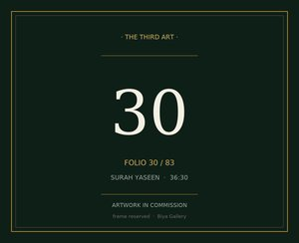
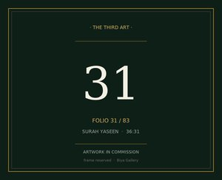
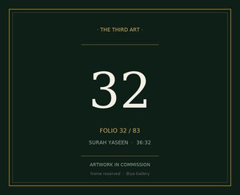

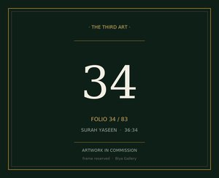


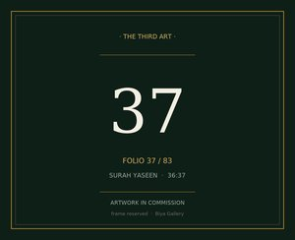


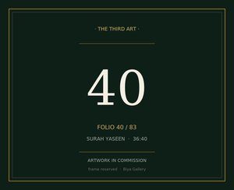
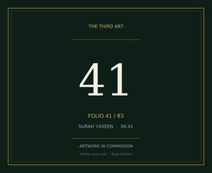
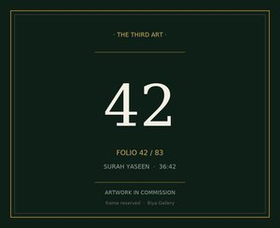
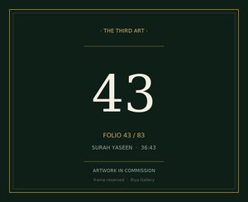
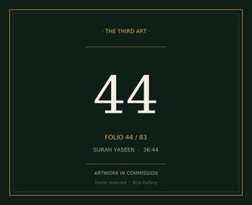
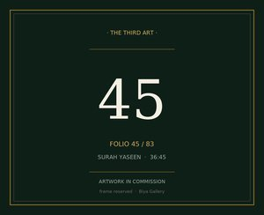
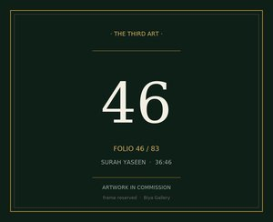
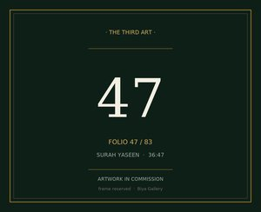
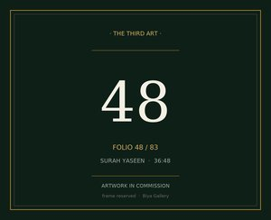
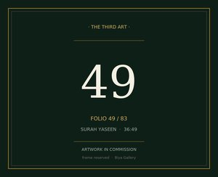
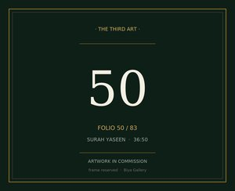
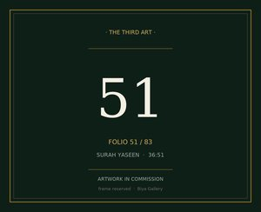
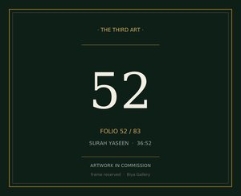
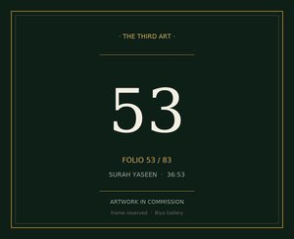
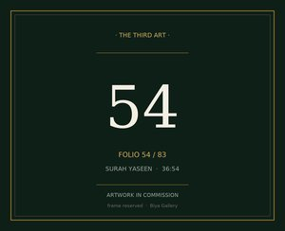
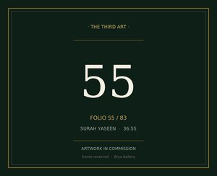
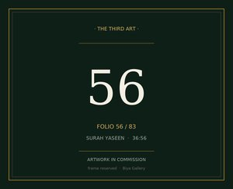



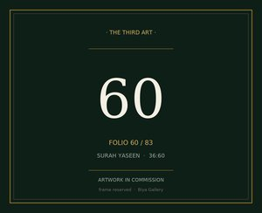
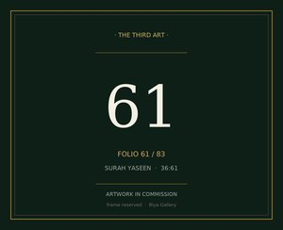






















THE COLLECTION · 83 VERSES
Eighty-three
folios, one verse each
Read left to right, top to bottom, in the order of the surah.
Each plate is a reserved frame: the verse stands verified today; the artwork is commissioned against it.
BIYA GALLERY · ART & CRAFT

Slide 15

THE THIRD ART · YASEEN 01 / 83
The Sacred Letters
"Ya Sin."
يس
01
SURA YASEEN (36) · MECCAN REVELATION
JUZ 22-23 · MANZIL 5 · MUSHAF PAGES 440-445
VERSE 36:01 · VERIFIED, UTHMANI CODEX
BIYA GALLERY · ART & CRAFT
Original art, Thread Art, poetry and craft from Lahore
COLLECTION · SERVICES · POETRY

Slide 16

THE THIRD ART · YASEEN 02 / 83
The Wise Qur'an
"We swear by the wise Qur'an."
وَٱلْقُرْءَانِ ٱلْحَكِيمِ
02
SURA YASEEN (36) · MECCAN REVELATION
JUZ 22-23 · MANZIL 5 · MUSHAF PAGES 440-445
VERSE 36:02 · VERIFIED, UTHMANI CODEX
BIYA GALLERY · ART & CRAFT
Original art, Thread Art, poetry and craft from Lahore
COLLECTION · SERVICES · POETRY

Slide 17

THE THIRD ART · YASEEN 03 / 83
Of the Messengers
"Lo! thou art of those sent."
إِنَّكَ لَمِنَ ٱلْمُرْسَلِينَ
03
SURA YASEEN (36) · MECCAN REVELATION
JUZ 22-23 · MANZIL 5 · MUSHAF PAGES 440-445
VERSE 36:03 · VERIFIED, UTHMANI CODEX
BIYA GALLERY · ART & CRAFT
Original art, Thread Art, poetry and craft from Lahore
COLLECTION · SERVICES · POETRY

Slide 18

THE THIRD ART · YASEEN 04 / 83
A Straight Path
"On a straight path."
عَلَىٰ صِرَٰطٍۢ مُّسْتَقِيمٍۢ
04
SURA YASEEN (36) · MECCAN REVELATION
JUZ 22-23 · MANZIL 5 · MUSHAF PAGES 440-445
VERSE 36:04 · VERIFIED, UTHMANI CODEX
BIYA GALLERY · ART & CRAFT
Original art, Thread Art, poetry and craft from Lahore
COLLECTION · SERVICES · POETRY

Slide 19

THE THIRD ART · YASEEN 05 / 83
The Mighty, the Merciful
"A revelation of the Mighty, the Merciful."
تَنزِيلَ ٱلْعَزِيزِ ٱلرَّحِيمِ
05
SURA YASEEN (36) · MECCAN REVELATION
JUZ 22-23 · MANZIL 5 · MUSHAF PAGES 440-445
VERSE 36:05 · VERIFIED, UTHMANI CODEX
BIYA GALLERY · ART & CRAFT
Original art, Thread Art, poetry and craft from Lahore
COLLECTION · SERVICES · POETRY

Slide 20

THE THIRD ART · YASEEN 06 / 83
A Heedless Folk
"That thou mayst warn a folk whose fathers were not warned, so they are heedless."
لِتُنذِرَ قَوْمًۭا مَّآ أُنذِرَ ءَابَآؤُهُمْ فَهُمْ غَٰفِلُونَ
06
SURA YASEEN (36) · MECCAN REVELATION
JUZ 22-23 · MANZIL 5 · MUSHAF PAGES 440-445
VERSE 36:06 · VERIFIED, UTHMANI CODEX
BIYA GALLERY · ART & CRAFT
Original art, Thread Art, poetry and craft from Lahore
COLLECTION · SERVICES · POETRY

Slide 21

THE THIRD ART · YASEEN 07 / 83
The Word Proved True
"Already hath the judgment proved true of most of them, for they believe not."
لَقَدْ حَقَّ ٱلْقَوْلُ عَلَىٰٓ أَكْثَرِهِمْ فَهُمْ لَا يُؤْمِنُونَ
07
SURA YASEEN (36) · MECCAN REVELATION
JUZ 22-23 · MANZIL 5 · MUSHAF PAGES 440-445
VERSE 36:07 · VERIFIED, UTHMANI CODEX
BIYA GALLERY · ART & CRAFT
Original art, Thread Art, poetry and craft from Lahore
COLLECTION · SERVICES · POETRY

Slide 22

THE THIRD ART · YASEEN 08 / 83
Yokes to the Chin
"We have put on their necks carcans reaching unto the chins, so that they are stiff-necked."
إِنَّا جَعَلْنَا فِىٓ أَعْنَٰقِهِمْ أَغْلَٰلًۭا فَهِىَ إِلَى ٱلْأَذْقَانِ فَهُم مُّقْمَحُونَ
08
SURA YASEEN (36) · MECCAN REVELATION
JUZ 22-23 · MANZIL 5 · MUSHAF PAGES 440-445
VERSE 36:08 · VERIFIED, UTHMANI CODEX
BIYA GALLERY · ART & CRAFT
Original art, Thread Art, poetry and craft from Lahore
COLLECTION · SERVICES · POETRY

Slide 23

THE THIRD ART · YASEEN 09 / 83
The Veil Before and Behind
"We have set a bar before them and a bar behind them, and have covered them so that they see not."
وَجَعَلْنَا مِنۢ بَيْنِ أَيْدِيهِمْ سَدًّۭا وَمِنْ خَلْفِهِمْ سَدًّۭا فَأَغْشَيْنَٰهُمْ فَهُمْ لَا يُبْصِرُونَ
09
SURA YASEEN (36) · MECCAN REVELATION
JUZ 22-23 · MANZIL 5 · MUSHAF PAGES 440-445
VERSE 36:09 · VERIFIED, UTHMANI CODEX
BIYA GALLERY · ART & CRAFT
Original art, Thread Art, poetry and craft from Lahore
COLLECTION · SERVICES · POETRY

Slide 24

THE THIRD ART · YASEEN 10 / 83
Warn or Not Warn
"Whether thou warn them or warn them not, it is alike for them, for they believe not."
وَسَوَآءٌ عَلَيْهِمْ ءَأَنذَرْتَهُمْ أَمْ لَمْ تُنذِرْهُمْ لَا يُؤْمِنُونَ
10
SURA YASEEN (36) · MECCAN REVELATION
JUZ 22-23 · MANZIL 5 · MUSHAF PAGES 440-445
VERSE 36:10 · VERIFIED, UTHMANI CODEX
BIYA GALLERY · ART & CRAFT
Original art, Thread Art, poetry and craft from Lahore
COLLECTION · SERVICES · POETRY

Slide 25

THE THIRD ART · YASEEN 11 / 83
The Reminder's Followers
"Thou warnest only him who followeth the Reminder and feareth the Beneficent in secret - to him, forgiveness and a rich reward."
إِنَّمَا تُنذِرُ مَنِ ٱتَّبَعَ ٱلذِّكْرَ وَخَشِىَ ٱلرَّحْمَٰنَ بِٱلْغَيْبِ ۖ فَبَشِّرْهُ بِمَغْفِرَةٍۢ وَأَجْرٍۢ كَرِيمٍ
11
SURA YASEEN (36) · MECCAN REVELATION
JUZ 22-23 · MANZIL 5 · MUSHAF PAGES 440-445
VERSE 36:11 · VERIFIED, UTHMANI CODEX
BIYA GALLERY · ART & CRAFT
Original art, Thread Art, poetry and craft from Lahore
COLLECTION · SERVICES · POETRY

Slide 26

THE THIRD ART · YASEEN 12 / 83
The Clear Register
"We bring the dead to life, and We keep all things recorded in a clear Register."
إِنَّا نَحْنُ نُحْىِ ٱلْمَوْتَىٰ وَنَكْتُبُ مَا قَدَّمُوا۟ وَءَاثَٰرَهُمْ ۚ وَكُلَّ شَىْءٍ أَحْصَيْنَٰهُ فِىٓ إِمَامٍۢ مُّبِينٍۢ
12
SURA YASEEN (36) · MECCAN REVELATION
JUZ 22-23 · MANZIL 5 · MUSHAF PAGES 440-445
VERSE 36:12 · VERIFIED, UTHMANI CODEX
BIYA GALLERY · ART & CRAFT
Original art, Thread Art, poetry and craft from Lahore
COLLECTION · SERVICES · POETRY

Slide 27

THE THIRD ART · YASEEN 13 / 83
The City's Similitude
"Coin for them a similitude: the people of the city when the messengers came unto them."
وَٱضْرِبْ لَهُم مَّثَلًا أَصْحَٰبَ ٱلْقَرْيَةِ إِذْ جَآءَهَا ٱلْمُرْسَلُونَ
13
SURA YASEEN (36) · MECCAN REVELATION
JUZ 22-23 · MANZIL 5 · MUSHAF PAGES 440-445
VERSE 36:13 · VERIFIED, UTHMANI CODEX
BIYA GALLERY · ART & CRAFT
Original art, Thread Art, poetry and craft from Lahore
COLLECTION · SERVICES · POETRY

Slide 28

THE THIRD ART · YASEEN 14 / 83
Two, Then a Third
"We sent unto them twain, and they denied them both, so We reinforced them with a third."
إِذْ أَرْسَلْنَآ إِلَيْهِمُ ٱثْنَيْنِ فَكَذَّبُوهُمَا فَعَزَّزْنَا بِثَالِثٍۢ فَقَالُوٓا۟ إِنَّآ إِلَيْكُم مُّرْسَلُونَ
14
SURA YASEEN (36) · MECCAN REVELATION
JUZ 22-23 · MANZIL 5 · MUSHAF PAGES 440-445
VERSE 36:14 · VERIFIED, UTHMANI CODEX
BIYA GALLERY · ART & CRAFT
Original art, Thread Art, poetry and craft from Lahore
COLLECTION · SERVICES · POETRY

Slide 29

THE THIRD ART · YASEEN 15 / 83
Mortals Like Ourselves
"They said: Ye are but mortals like unto us; ye do but lie!"
قَالُوا۟ مَآ أَنتُمْ إِلَّا بَشَرٌۭ مِّثْلُنَا وَمَآ أَنزَلَ ٱلرَّحْمَٰنُ مِن شَىْءٍ إِنْ أَنتُمْ إِلَّا تَكْذِبُونَ
15
SURA YASEEN (36) · MECCAN REVELATION
JUZ 22-23 · MANZIL 5 · MUSHAF PAGES 440-445
VERSE 36:15 · VERIFIED, UTHMANI CODEX
BIYA GALLERY · ART & CRAFT
Original art, Thread Art, poetry and craft from Lahore
COLLECTION · SERVICES · POETRY

Slide 30

THE THIRD ART · YASEEN 16 / 83
Our Lord Knoweth
"They answered: Our Lord knoweth that we are indeed sent unto you."
قَالُوا۟ رَبُّنَا يَعْلَمُ إِنَّآ إِلَيْكُمْ لَمُرْسَلُونَ
16
SURA YASEEN (36) · MECCAN REVELATION
JUZ 22-23 · MANZIL 5 · MUSHAF PAGES 440-445
VERSE 36:16 · VERIFIED, UTHMANI CODEX
BIYA GALLERY · ART & CRAFT
Original art, Thread Art, poetry and craft from Lahore
COLLECTION · SERVICES · POETRY

Slide 31

THE THIRD ART · YASEEN 17 / 83
Plain Conveyance
"And our duty is but plain conveyance of the message."
وَمَا عَلَيْنَآ إِلَّا ٱلْبَلَٰغُ ٱلْمُبِينُ
17
SURA YASEEN (36) · MECCAN REVELATION
JUZ 22-23 · MANZIL 5 · MUSHAF PAGES 440-445
VERSE 36:17 · VERIFIED, UTHMANI CODEX
BIYA GALLERY · ART & CRAFT
Original art, Thread Art, poetry and craft from Lahore
COLLECTION · SERVICES · POETRY

Slide 32

THE THIRD ART · YASEEN 18 / 83
We Augur Ill of You
"They said: We augur ill of you - if ye desist not, we shall surely stone you."
قَالُوٓا۟ إِنَّا تَطَيَّرْنَا بِكُمْ ۖ لَئِن لَّمْ تَنتَهُوا۟ لَنَرْجُمَنَّكُمْ وَلَيَمَسَّنَّكُم مِّنَّا عَذَابٌ أَلِيمٌۭ
18
SURA YASEEN (36) · MECCAN REVELATION
JUZ 22-23 · MANZIL 5 · MUSHAF PAGES 440-445
VERSE 36:18 · VERIFIED, UTHMANI CODEX
BIYA GALLERY · ART & CRAFT
Original art, Thread Art, poetry and craft from Lahore
COLLECTION · SERVICES · POETRY

Slide 33

THE THIRD ART · YASEEN 19 / 83
Your Omen Be With You
"Your evil augury be with you! Nay, but ye are froward folk!"
قَالُوا۟ طَٰٓئِرُكُم مَّعَكُمْ ۚ أَئِن ذُكِّرْتُمْ ۚ بَلْ أَنتُمْ قَوْمٌۭ مُّسْرِفُونَ
19
SURA YASEEN (36) · MECCAN REVELATION
JUZ 22-23 · MANZIL 5 · MUSHAF PAGES 440-445
VERSE 36:19 · VERIFIED, UTHMANI CODEX
BIYA GALLERY · ART & CRAFT
Original art, Thread Art, poetry and craft from Lahore
COLLECTION · SERVICES · POETRY

Slide 34

THE THIRD ART · YASEEN 20 / 83
The Man from the City
"There came from the uttermost part of the city a man running: O my people, follow those who have been sent!"
وَجَآءَ مِنْ أَقْصَا ٱلْمَدِينَةِ رَجُلٌۭ يَسْعَىٰ قَالَ يَٰقَوْمِ ٱتَّبِعُوا۟ ٱلْمُرْسَلِينَ
20
SURA YASEEN (36) · MECCAN REVELATION
JUZ 22-23 · MANZIL 5 · MUSHAF PAGES 440-445
VERSE 36:20 · VERIFIED, UTHMANI CODEX
BIYA GALLERY · ART & CRAFT
Original art, Thread Art, poetry and craft from Lahore
COLLECTION · SERVICES · POETRY

Slide 35

THE THIRD ART · YASEEN 21 / 83
Those Who Ask No Fee
"Follow those who ask of you no fee, and who are rightly guided."
ٱتَّبِعُوا۟ مَن لَّا يَسْـَٔلُكُمْ أَجْرًا وَهُمْ مُّهْتَدُونَ
21
SURA YASEEN (36) · MECCAN REVELATION
JUZ 22-23 · MANZIL 5 · MUSHAF PAGES 440-445
VERSE 36:21 · VERIFIED, UTHMANI CODEX
BIYA GALLERY · ART & CRAFT
Original art, Thread Art, poetry and craft from Lahore
COLLECTION · SERVICES · POETRY

Slide 36

THE THIRD ART · YASEEN 22 / 83
For What Cause
"For what cause should I not serve Him Who hath created me, and unto Whom ye will be brought back?"
وَمَا لِىَ لَآ أَعْبُدُ ٱلَّذِى فَطَرَنِى وَإِلَيْهِ تُرْجَعُونَ
22
SURA YASEEN (36) · MECCAN REVELATION
JUZ 22-23 · MANZIL 5 · MUSHAF PAGES 440-445
VERSE 36:22 · VERIFIED, UTHMANI CODEX
BIYA GALLERY · ART & CRAFT
Original art, Thread Art, poetry and craft from Lahore
COLLECTION · SERVICES · POETRY

Slide 37

THE THIRD ART · YASEEN 23 / 83
Gods in His Place
"Shall I take other gods in His place, when their intercession will avail me naught, nor can they save?"
ءَأَتَّخِذُ مِن دُونِهِۦٓ ءَالِهَةً إِن يُرِدْنِ ٱلرَّحْمَٰنُ بِضُرٍّ لَّا تُغْنِ عَنِّى شَفَٰعَتُهُمْ شَيْـًۭٔا وَلَا يُنقِذُونِ
23
SURA YASEEN (36) · MECCAN REVELATION
JUZ 22-23 · MANZIL 5 · MUSHAF PAGES 440-445
VERSE 36:23 · VERIFIED, UTHMANI CODEX
BIYA GALLERY · ART & CRAFT
Original art, Thread Art, poetry and craft from Lahore
COLLECTION · SERVICES · POETRY

Slide 38

THE THIRD ART · YASEEN 24 / 83
Error Manifest
"Then truly I should be in error manifest."
إِنِّىٓ إِذًۭا لَّفِى ضَلَٰلٍۢ مُّبِينٍ
24
SURA YASEEN (36) · MECCAN REVELATION
JUZ 22-23 · MANZIL 5 · MUSHAF PAGES 440-445
VERSE 36:24 · VERIFIED, UTHMANI CODEX
BIYA GALLERY · ART & CRAFT
Original art, Thread Art, poetry and craft from Lahore
COLLECTION · SERVICES · POETRY

Slide 39

THE THIRD ART · YASEEN 25 / 83
I Have Believed
"Lo! I have believed in your Lord, so hear me!"
إِنِّىٓ ءَامَنتُ بِرَبِّكُمْ فَٱسْمَعُونِ
25
SURA YASEEN (36) · MECCAN REVELATION
JUZ 22-23 · MANZIL 5 · MUSHAF PAGES 440-445
VERSE 36:25 · VERIFIED, UTHMANI CODEX
BIYA GALLERY · ART & CRAFT
Original art, Thread Art, poetry and craft from Lahore
COLLECTION · SERVICES · POETRY

Slide 40

THE THIRD ART · YASEEN 26 / 83
Enter Paradise
"It was said unto him: Enter paradise. He said: Would that my people knew."
قِيلَ ٱدْخُلِ ٱلْجَنَّةَ ۖ قَالَ يَٰلَيْتَ قَوْمِى يَعْلَمُونَ
26
SURA YASEEN (36) · MECCAN REVELATION
JUZ 22-23 · MANZIL 5 · MUSHAF PAGES 440-445
VERSE 36:26 · VERIFIED, UTHMANI CODEX
BIYA GALLERY · ART & CRAFT
Original art, Thread Art, poetry and craft from Lahore
COLLECTION · SERVICES · POETRY

Slide 41

THE THIRD ART · YASEEN 27 / 83
The Honoured Ones
"With what munificence my Lord hath pardoned me and made me of the honoured ones!"
بِمَا غَفَرَ لِى رَبِّى وَجَعَلَنِى مِنَ ٱلْمُكْرَمِينَ
27
SURA YASEEN (36) · MECCAN REVELATION
JUZ 22-23 · MANZIL 5 · MUSHAF PAGES 440-445
VERSE 36:27 · VERIFIED, UTHMANI CODEX
BIYA GALLERY · ART & CRAFT
Original art, Thread Art, poetry and craft from Lahore
COLLECTION · SERVICES · POETRY

Slide 42

THE THIRD ART · YASEEN 28 / 83
No Host from Heaven
"We sent not down against his people a host from heaven, nor do We ever send."
وَمَا أَنزَلْنَا عَلَىٰ قَوْمِهِۦ مِنۢ بَعْدِهِۦ مِن جُندٍۢ مِّنَ ٱلسَّمَآءِ وَمَا كُنَّا مُنزِلِينَ
28
SURA YASEEN (36) · MECCAN REVELATION
JUZ 22-23 · MANZIL 5 · MUSHAF PAGES 440-445
VERSE 36:28 · VERIFIED, UTHMANI CODEX
BIYA GALLERY · ART & CRAFT
Original art, Thread Art, poetry and craft from Lahore
COLLECTION · SERVICES · POETRY

Slide 43

THE THIRD ART · YASEEN 29 / 83
One Shout
"It was but one Shout, and lo! they were extinct."
إِن كَانَتْ إِلَّا صَيْحَةًۭ وَٰحِدَةًۭ فَإِذَا هُمْ خَٰمِدُونَ
29
SURA YASEEN (36) · MECCAN REVELATION
JUZ 22-23 · MANZIL 5 · MUSHAF PAGES 440-445
VERSE 36:29 · VERIFIED, UTHMANI CODEX
BIYA GALLERY · ART & CRAFT
Original art, Thread Art, poetry and craft from Lahore
COLLECTION · SERVICES · POETRY

Slide 44

THE THIRD ART · YASEEN 30 / 83
Woe to the Bondmen
"Ah, the anguish for the bondmen! Never came a messenger but they mocked him!"
يَٰحَسْرَةً عَلَى ٱلْعِبَادِ ۚ مَا يَأْتِيهِم مِّن رَّسُولٍ إِلَّا كَانُوا۟ بِهِۦ يَسْتَهْزِءُونَ
30
SURA YASEEN (36) · MECCAN REVELATION
JUZ 22-23 · MANZIL 5 · MUSHAF PAGES 440-445
VERSE 36:30 · VERIFIED, UTHMANI CODEX
BIYA GALLERY · ART & CRAFT
Original art, Thread Art, poetry and craft from Lahore
COLLECTION · SERVICES · POETRY

Slide 45

THE THIRD ART · YASEEN 31 / 83
Generations Destroyed
"Have they not seen how many generations We destroyed before them, which returned not?"
أَلَمْ يَرَوْا۟ كَمْ أَهْلَكْنَا قَبْلَهُم مِّنَ ٱلْقُرُونِ أَنَّهُمْ إِلَيْهِمْ لَا يَرْجِعُونَ
31
SURA YASEEN (36) · MECCAN REVELATION
JUZ 22-23 · MANZIL 5 · MUSHAF PAGES 440-445
VERSE 36:31 · VERIFIED, UTHMANI CODEX
BIYA GALLERY · ART & CRAFT
Original art, Thread Art, poetry and craft from Lahore
COLLECTION · SERVICES · POETRY

Slide 46

THE THIRD ART · YASEEN 32 / 83
All Brought Before Us
"But all, without exception, will be brought before Us."
وَإِن كُلٌّۭ لَّمَّا جَمِيعٌۭ لَّدَيْنَا مُحْضَرُونَ
32
SURA YASEEN (36) · MECCAN REVELATION
JUZ 22-23 · MANZIL 5 · MUSHAF PAGES 440-445
VERSE 36:32 · VERIFIED, UTHMANI CODEX
BIYA GALLERY · ART & CRAFT
Original art, Thread Art, poetry and craft from Lahore
COLLECTION · SERVICES · POETRY

Slide 47

THE THIRD ART · YASEEN 33 / 83
The Dead Earth Revived
"A token is the dead earth: We revive it and bring forth grain so that they eat thereof."
وَءَايَةٌۭ لَّهُمُ ٱلْأَرْضُ ٱلْمَيْتَةُ أَحْيَيْنَٰهَا وَأَخْرَجْنَا مِنْهَا حَبًّۭا فَمِنْهُ يَأْكُلُونَ
33
SURA YASEEN (36) · MECCAN REVELATION
JUZ 22-23 · MANZIL 5 · MUSHAF PAGES 440-445
VERSE 36:33 · VERIFIED, UTHMANI CODEX
BIYA GALLERY · ART & CRAFT
Original art, Thread Art, poetry and craft from Lahore
COLLECTION · SERVICES · POETRY

Slide 48

THE THIRD ART · YASEEN 34 / 83
Gardens of the Date-Palm
"We placed therein gardens of the date-palm and grapes, and springs gushing forth."
وَجَعَلْنَا فِيهَا جَنَّٰتٍۢ مِّن نَّخِيلٍۢ وَأَعْنَٰبٍۢ وَفَجَّرْنَا فِيهَا مِنَ ٱلْعُيُونِ
34
SURA YASEEN (36) · MECCAN REVELATION
JUZ 22-23 · MANZIL 5 · MUSHAF PAGES 440-445
VERSE 36:34 · VERIFIED, UTHMANI CODEX
BIYA GALLERY · ART & CRAFT
Original art, Thread Art, poetry and craft from Lahore
COLLECTION · SERVICES · POETRY

Slide 49

THE THIRD ART · YASEEN 35 / 83
What Their Hands Made Not
"That they may eat of the fruit thereof, and their hands made it not. Will they not give thanks?"
لِيَأْكُلُوا۟ مِن ثَمَرِهِۦ وَمَا عَمِلَتْهُ أَيْدِيهِمْ ۖ أَفَلَا يَشْكُرُونَ
35
SURA YASEEN (36) · MECCAN REVELATION
JUZ 22-23 · MANZIL 5 · MUSHAF PAGES 440-445
VERSE 36:35 · VERIFIED, UTHMANI CODEX
BIYA GALLERY · ART & CRAFT
Original art, Thread Art, poetry and craft from Lahore
COLLECTION · SERVICES · POETRY

Slide 50

THE THIRD ART · YASEEN 36 / 83
All the Pairs
"Glory be to Him Who created all the pairs, of the earth's growth, and of themselves, and of that which they know not!"
سُبْحَٰنَ ٱلَّذِى خَلَقَ ٱلْأَزْوَٰجَ كُلَّهَا مِمَّا تُنۢبِتُ ٱلْأَرْضُ وَمِنْ أَنفُسِهِمْ وَمِمَّا لَا يَعْلَمُونَ
36
SURA YASEEN (36) · MECCAN REVELATION
JUZ 22-23 · MANZIL 5 · MUSHAF PAGES 440-445
VERSE 36:36 · VERIFIED, UTHMANI CODEX
BIYA GALLERY · ART & CRAFT
Original art, Thread Art, poetry and craft from Lahore
COLLECTION · SERVICES · POETRY

Slide 51

THE THIRD ART · YASEEN 37 / 83
Night Stripped of Day
"A token is night: We strip it of the day, and lo! they are in darkness."
وَءَايَةٌۭ لَّهُمُ ٱلَّيۡلُ نَسْلَخُ مِنْهُ ٱلنَّهَارَ فَإِذَا هُم مُّظْلِمُونَ
37
SURA YASEEN (36) · MECCAN REVELATION
JUZ 22-23 · MANZIL 5 · MUSHAF PAGES 440-445
VERSE 36:37 · VERIFIED, UTHMANI CODEX
BIYA GALLERY · ART & CRAFT
Original art, Thread Art, poetry and craft from Lahore
COLLECTION · SERVICES · POETRY

Slide 52

THE THIRD ART · YASEEN 38 / 83
The Sun's Resting-Place
"And the sun runneth unto a resting-place for it: that is the measuring of the Mighty, the Wise."
وَٱلشَّمْسُ تَجْرِى لِمُسْتَقَرٍّۢ لَّهَا ۚ ذَٰلِكَ تَقْدِيرُ ٱلْعَزِيزِ ٱلْعَلِيمِ
38
SURA YASEEN (36) · MECCAN REVELATION
JUZ 22-23 · MANZIL 5 · MUSHAF PAGES 440-445
VERSE 36:38 · VERIFIED, UTHMANI CODEX
BIYA GALLERY · ART & CRAFT
Original art, Thread Art, poetry and craft from Lahore
COLLECTION · SERVICES · POETRY

Slide 53

THE THIRD ART · YASEEN 39 / 83
The Moon's Mansions
"For the moon We appointed mansions till she return like an old shrivelled palm-leaf."
وَٱلْقَمَرَ قَدَّرْنَٰهُ مَنَازِلَ حَتَّىٰ عَادَ كَٱلْعُرْجُونِ ٱلْقَدِيمِ
39
SURA YASEEN (36) · MECCAN REVELATION
JUZ 22-23 · MANZIL 5 · MUSHAF PAGES 440-445
VERSE 36:39 · VERIFIED, UTHMANI CODEX
BIYA GALLERY · ART & CRAFT
Original art, Thread Art, poetry and craft from Lahore
COLLECTION · SERVICES · POETRY

Slide 54

THE THIRD ART · YASEEN 40 / 83
Each in an Orbit
"The sun cannot overtake the moon, nor does night outstrip the day; each floateth in an orbit."
لَا ٱلشَّمْسُ يَنۢبَغِى لَهَآ أَن تُدْرِكَ ٱلْقَمَرَ وَلَا ٱلَّيۡلُ سَابِقُ ٱلنَّهَارِ ۚ وَكُلٌّۭ فِى فَلَكٍۢ يَسْبَحُونَ
40
SURA YASEEN (36) · MECCAN REVELATION
JUZ 22-23 · MANZIL 5 · MUSHAF PAGES 440-445
VERSE 36:40 · VERIFIED, UTHMANI CODEX
BIYA GALLERY · ART & CRAFT
Original art, Thread Art, poetry and craft from Lahore
COLLECTION · SERVICES · POETRY

Slide 55

THE THIRD ART · YASEEN 41 / 83
The Laden Ship
"A token is that We bear their offspring in the laden ship."
وَءَايَةٌۭ لَّهُمْ أَنَّا حَمَلْنَا ذُرِّيَّتَهُمْ فِى ٱلْفُلْكِ ٱلْمَشْحُونِ
41
SURA YASEEN (36) · MECCAN REVELATION
JUZ 22-23 · MANZIL 5 · MUSHAF PAGES 440-445
VERSE 36:41 · VERIFIED, UTHMANI CODEX
BIYA GALLERY · ART & CRAFT
Original art, Thread Art, poetry and craft from Lahore
COLLECTION · SERVICES · POETRY

Slide 56

THE THIRD ART · YASEEN 42 / 83
Of the Like Whereon They Ride
"And We created for them of the like thereof whereon they ride."
وَخَلَقْنَا لَهُم مِّن مِّثْلِهِۦ مَا يَرْكَبُونَ
42
SURA YASEEN (36) · MECCAN REVELATION
JUZ 22-23 · MANZIL 5 · MUSHAF PAGES 440-445
VERSE 36:42 · VERIFIED, UTHMANI CODEX
BIYA GALLERY · ART & CRAFT
Original art, Thread Art, poetry and craft from Lahore
COLLECTION · SERVICES · POETRY

Slide 57

THE THIRD ART · YASEEN 43 / 83
Drowning Without Help
"If We will, We drown them, and there is no help for them, neither can they be saved."
وَإِن نَّشَأْ نُغْرِقْهُمْ فَلَا صَرِيخَ لَهُمْ وَلَا هُمْ يُنقَذُونَ
43
SURA YASEEN (36) · MECCAN REVELATION
JUZ 22-23 · MANZIL 5 · MUSHAF PAGES 440-445
VERSE 36:43 · VERIFIED, UTHMANI CODEX
BIYA GALLERY · ART & CRAFT
Original art, Thread Art, poetry and craft from Lahore
COLLECTION · SERVICES · POETRY

Slide 58

THE THIRD ART · YASEEN 44 / 83
Mercy for a While
"Unless by mercy from Us and as comfort for a while."
إِلَّا رَحْمَةًۭ مِّنَّا وَمَتَٰعًا إِلَىٰ حِينٍۢ
44
SURA YASEEN (36) · MECCAN REVELATION
JUZ 22-23 · MANZIL 5 · MUSHAF PAGES 440-445
VERSE 36:44 · VERIFIED, UTHMANI CODEX
BIYA GALLERY · ART & CRAFT
Original art, Thread Art, poetry and craft from Lahore
COLLECTION · SERVICES · POETRY

Slide 59

THE THIRD ART · YASEEN 45 / 83
Before You and Behind You
"When it is said: Beware of that which is before you and that which is behind you, that haply ye may find mercy."
وَإِذَا قِيلَ لَهُمُ ٱتَّقُوا۟ مَا بَيْنَ أَيْدِيكُمْ وَمَا خَلْفَكُمْ لَعَلَّكُمْ تُرْحَمُونَ
45
SURA YASEEN (36) · MECCAN REVELATION
JUZ 22-23 · MANZIL 5 · MUSHAF PAGES 440-445
VERSE 36:45 · VERIFIED, UTHMANI CODEX
BIYA GALLERY · ART & CRAFT
Original art, Thread Art, poetry and craft from Lahore
COLLECTION · SERVICES · POETRY

Slide 60

THE THIRD ART · YASEEN 46 / 83
They Turn Away
"Never came a token of their Lord to them, but they turned away from it!"
وَمَا تَأْتِيهِم مِّنْ ءَايَةٍۢ مِّنْ ءَايَٰتِ رَبِّهِمْ إِلَّا كَانُوا۟ عَنْهَا مُعْرِضِينَ
46
SURA YASEEN (36) · MECCAN REVELATION
JUZ 22-23 · MANZIL 5 · MUSHAF PAGES 440-445
VERSE 36:46 · VERIFIED, UTHMANI CODEX
BIYA GALLERY · ART & CRAFT
Original art, Thread Art, poetry and craft from Lahore
COLLECTION · SERVICES · POETRY

Slide 61

THE THIRD ART · YASEEN 47 / 83
Shall We Feed Them
"When it is said: Spend of that Allah hath provided you, they say: Shall we feed them?"
وَإِذَا قِيلَ لَهُمْ أَنفِقُوا۟ مِمَّا رَزَقَكُمُ ٱللَّهُ قَالَ ٱلَّذِينَ كَفَرُوا۟ لِلَّذِينَ ءَامَنُوٓا۟ أَنُطْعِمُ مَن لَّوْ يَشَآءُ ٱللَّهُ أَطْعَمَهُۥٓ إِنْ أَنتُمْ إِلَّا فِى ضَلَٰلٍۢ مُّبِينٍۢ
47
SURA YASEEN (36) · MECCAN REVELATION
JUZ 22-23 · MANZIL 5 · MUSHAF PAGES 440-445
VERSE 36:47 · VERIFIED, UTHMANI CODEX
BIYA GALLERY · ART & CRAFT
Original art, Thread Art, poetry and craft from Lahore
COLLECTION · SERVICES · POETRY

Slide 62

THE THIRD ART · YASEEN 48 / 83
When This Promise
"And they say: When will this promise be, if ye are truthful?"
وَيَقُولُونَ مَتَىٰ هَٰذَا ٱلْوَعْدُ إِن كُنتُمْ صَٰدِقِينَ
48
SURA YASEEN (36) · MECCAN REVELATION
JUZ 22-23 · MANZIL 5 · MUSHAF PAGES 440-445
VERSE 36:48 · VERIFIED, UTHMANI CODEX
BIYA GALLERY · ART & CRAFT
Original art, Thread Art, poetry and craft from Lahore
COLLECTION · SERVICES · POETRY

Slide 63

THE THIRD ART · YASEEN 49 / 83
A Shout While Disputing
"They await but one Shout, which will take them while they are disputing."
مَا يَنظُرُونَ إِلَّا صَيْحَةًۭ وَٰحِدَةًۭ تَأْخُذُهُمْ وَهُمْ يَخِصِّمُونَ
49
SURA YASEEN (36) · MECCAN REVELATION
JUZ 22-23 · MANZIL 5 · MUSHAF PAGES 440-445
VERSE 36:49 · VERIFIED, UTHMANI CODEX
BIYA GALLERY · ART & CRAFT
Original art, Thread Art, poetry and craft from Lahore
COLLECTION · SERVICES · POETRY

Slide 64

THE THIRD ART · YASEEN 50 / 83
No Bequest, No Return
"Then they cannot make bequest, nor can they return to their own folk."
فَلَا يَسْتَطِيعُونَ تَوْصِيَةًۭ وَلَآ إِلَىٰٓ أَهْلِهِمْ يَرْجِعُونَ
50
SURA YASEEN (36) · MECCAN REVELATION
JUZ 22-23 · MANZIL 5 · MUSHAF PAGES 440-445
VERSE 36:50 · VERIFIED, UTHMANI CODEX
BIYA GALLERY · ART & CRAFT
Original art, Thread Art, poetry and craft from Lahore
COLLECTION · SERVICES · POETRY

Slide 65

THE THIRD ART · YASEEN 51 / 83
The Trumpet Blown
"And the trumpet is blown, and lo! from the graves they hie unto their Lord."
وَنُفِخَ فِى ٱلصُّورِ فَإِذَا هُم مِّنَ ٱلْأَجْدَاثِ إِلَىٰ رَبِّهِمْ يَنسِلُونَ
51
SURA YASEEN (36) · MECCAN REVELATION
JUZ 22-23 · MANZIL 5 · MUSHAF PAGES 440-445
VERSE 36:51 · VERIFIED, UTHMANI CODEX
BIYA GALLERY · ART & CRAFT
Original art, Thread Art, poetry and craft from Lahore
COLLECTION · SERVICES · POETRY

Slide 66

THE THIRD ART · YASEEN 52 / 83
Woe Upon Us
"They cry: Woe upon us! Who hath raised us from our sleep? The Beneficent did promise, and the messengers spoke truth."
قَالُوا۟ يَٰوَيْلَنَا مَنۢ بَعَثَنَا مِن مَّرْقَدِنَا ۜ ۗ هَٰذَا مَا وَعَدَ ٱلرَّحْمَٰنُ وَصَدَقَ ٱلْمُرْسَلُونَ
52
SURA YASEEN (36) · MECCAN REVELATION
JUZ 22-23 · MANZIL 5 · MUSHAF PAGES 440-445
VERSE 36:52 · VERIFIED, UTHMANI CODEX
BIYA GALLERY · ART & CRAFT
Original art, Thread Art, poetry and craft from Lahore
COLLECTION · SERVICES · POETRY

Slide 67

THE THIRD ART · YASEEN 53 / 83
The Assembly Before Him
"It is but one Shout, and behold them assembled before Us!"
إِن كَانَتْ إِلَّا صَيْحَةًۭ وَٰحِدَةًۭ فَإِذَا هُمْ جَمِيعٌۭ لَّدَيْنَا مُحْضَرُونَ
53
SURA YASEEN (36) · MECCAN REVELATION
JUZ 22-23 · MANZIL 5 · MUSHAF PAGES 440-445
VERSE 36:53 · VERIFIED, UTHMANI CODEX
BIYA GALLERY · ART & CRAFT
Original art, Thread Art, poetry and craft from Lahore
COLLECTION · SERVICES · POETRY

Slide 68

THE THIRD ART · YASEEN 54 / 83
No Soul Wronged
"This day no soul is wronged in aught; ye are requited only what ye used to do."
فَٱلْيَوْمَ لَا تُظْلَمُ نَفْسٌۭ شَيْـًۭٔا وَلَا تُجْزَوْنَ إِلَّا مَا كُنتُمْ تَعْمَلُونَ
54
SURA YASEEN (36) · MECCAN REVELATION
JUZ 22-23 · MANZIL 5 · MUSHAF PAGES 440-445
VERSE 36:54 · VERIFIED, UTHMANI CODEX
BIYA GALLERY · ART & CRAFT
Original art, Thread Art, poetry and craft from Lahore
COLLECTION · SERVICES · POETRY

Slide 69

THE THIRD ART · YASEEN 55 / 83
Happily Employed
"Those who merit paradise this day are happily employed."
إِنَّ أَصْحَٰبَ ٱلْجَنَّةِ ٱلْيَوْمَ فِى شُغُلٍۢ فَٰكِهُونَ
55
SURA YASEEN (36) · MECCAN REVELATION
JUZ 22-23 · MANZIL 5 · MUSHAF PAGES 440-445
VERSE 36:55 · VERIFIED, UTHMANI CODEX
BIYA GALLERY · ART & CRAFT
Original art, Thread Art, poetry and craft from Lahore
COLLECTION · SERVICES · POETRY

Slide 70

THE THIRD ART · YASEEN 56 / 83
On Thrones in Shade
"They and their wives, in pleasant shade, upon thrones reclining."
هُمْ وَأَزْوَٰجُهُمْ فِى ظِلَٰلٍ عَلَى ٱلْأَرَآئِكِ مُتَّكِـُٔونَ
56
SURA YASEEN (36) · MECCAN REVELATION
JUZ 22-23 · MANZIL 5 · MUSHAF PAGES 440-445
VERSE 36:56 · VERIFIED, UTHMANI CODEX
BIYA GALLERY · ART & CRAFT
Original art, Thread Art, poetry and craft from Lahore
COLLECTION · SERVICES · POETRY

Slide 71

THE THIRD ART · YASEEN 57 / 83
Fruit and All They Ask
"Theirs is the fruit of their deeds, and theirs all that they ask."
لَهُمْ فِيهَا فَٰكِهَةٌۭ وَلَهُم مَّا يَدَّعُونَ
57
SURA YASEEN (36) · MECCAN REVELATION
JUZ 22-23 · MANZIL 5 · MUSHAF PAGES 440-445
VERSE 36:57 · VERIFIED, UTHMANI CODEX
BIYA GALLERY · ART & CRAFT
Original art, Thread Art, poetry and craft from Lahore
COLLECTION · SERVICES · POETRY

Slide 72

THE THIRD ART · YASEEN 58 / 83
Peace from the Lord
"The word from a Merciful Lord is: Peace!"
سَلَٰمٌۭ قَوْلًۭا مِّن رَّبٍّۢ رَّحِيمٍۢ
58
SURA YASEEN (36) · MECCAN REVELATION
JUZ 22-23 · MANZIL 5 · MUSHAF PAGES 440-445
VERSE 36:58 · VERIFIED, UTHMANI CODEX
BIYA GALLERY · ART & CRAFT
Original art, Thread Art, poetry and craft from Lahore
COLLECTION · SERVICES · POETRY

Slide 73

THE THIRD ART · YASEEN 59 / 83
Depart, O Guilty
"But depart, O guilty ones, this day!"
وَٱمْتَٰزُوا۟ ٱلْيَوْمَ أَيُّهَا ٱلْمُجْرِمُونَ
59
SURA YASEEN (36) · MECCAN REVELATION
JUZ 22-23 · MANZIL 5 · MUSHAF PAGES 440-445
VERSE 36:59 · VERIFIED, UTHMANI CODEX
BIYA GALLERY · ART & CRAFT
Original art, Thread Art, poetry and craft from Lahore
COLLECTION · SERVICES · POETRY

Slide 74

THE THIRD ART · YASEEN 60 / 83
The Ancient Charge
"Did I not charge you, O sons of Adam, not to worship the devil - your open foe?"
أَلَمْ أَعْهَدْ إِلَيْكُمْ يَٰبَنِىٓ ءَادَمَ أَن لَّا تَعْبُدُوا۟ ٱلشَّيْطَٰنَ ۖ إِنَّهُۥ لَكُمْ عَدُوٌّۭ مُّبِينٌۭ
60
SURA YASEEN (36) · MECCAN REVELATION
JUZ 22-23 · MANZIL 5 · MUSHAF PAGES 440-445
VERSE 36:60 · VERIFIED, UTHMANI CODEX
BIYA GALLERY · ART & CRAFT
Original art, Thread Art, poetry and craft from Lahore
COLLECTION · SERVICES · POETRY

Slide 75

THE THIRD ART · YASEEN 61 / 83
The Right Path
"But to worship Me: that was the right path."
وَأَنِ ٱعْبُدُونِ ۚ هَٰذَا صِرَٰطٌۭ مُّسْتَقِيمٌۭ
61
SURA YASEEN (36) · MECCAN REVELATION
JUZ 22-23 · MANZIL 5 · MUSHAF PAGES 440-445
VERSE 36:61 · VERIFIED, UTHMANI CODEX
BIYA GALLERY · ART & CRAFT
Original art, Thread Art, poetry and craft from Lahore
COLLECTION · SERVICES · POETRY

Slide 76

THE THIRD ART · YASEEN 62 / 83
A Great Multitude
"Yet he hath led astray of you a great multitude. Had ye then no sense?"
وَلَقَدْ أَضَلَّ مِنكُمْ جِبِلًّۭا كَثِيرًا ۖ أَفَلَمْ تَكُونُوا۟ تَعْقِلُونَ
62
SURA YASEEN (36) · MECCAN REVELATION
JUZ 22-23 · MANZIL 5 · MUSHAF PAGES 440-445
VERSE 36:62 · VERIFIED, UTHMANI CODEX
BIYA GALLERY · ART & CRAFT
Original art, Thread Art, poetry and craft from Lahore
COLLECTION · SERVICES · POETRY

Slide 77

THE THIRD ART · YASEEN 63 / 83
This Is Hell
"This is hell which ye were promised."
هَٰذِهِۦ جَهَنَّمُ ٱلَّتِى كُنتُمْ تُوعَدُونَ
63
SURA YASEEN (36) · MECCAN REVELATION
JUZ 22-23 · MANZIL 5 · MUSHAF PAGES 440-445
VERSE 36:63 · VERIFIED, UTHMANI CODEX
BIYA GALLERY · ART & CRAFT
Original art, Thread Art, poetry and craft from Lahore
COLLECTION · SERVICES · POETRY

Slide 78

THE THIRD ART · YASEEN 64 / 83
Burn This Day
"Burn therein this day for that ye disbelieved."
ٱصْلَوْهَا ٱلْيَوْمَ بِمَا كُنتُمْ تَكْفُرُونَ
64
SURA YASEEN (36) · MECCAN REVELATION
JUZ 22-23 · MANZIL 5 · MUSHAF PAGES 440-445
VERSE 36:64 · VERIFIED, UTHMANI CODEX
BIYA GALLERY · ART & CRAFT
Original art, Thread Art, poetry and craft from Lahore
COLLECTION · SERVICES · POETRY

Slide 79

THE THIRD ART · YASEEN 65 / 83
Hands That Speak
"This day We seal their mouths; their hands speak and their feet bear witness."
ٱلْيَوْمَ نَخْتِمُ عَلَىٰٓ أَفْوَٰهِهِمْ وَتُكَلِّمُنَآ أَيْدِيهِمْ وَتَشْهَدُ أَرْجُلُهُم بِمَا كَانُوا۟ يَكْسِبُونَ
65
SURA YASEEN (36) · MECCAN REVELATION
JUZ 22-23 · MANZIL 5 · MUSHAF PAGES 440-445
VERSE 36:65 · VERIFIED, UTHMANI CODEX
BIYA GALLERY · ART & CRAFT
Original art, Thread Art, poetry and craft from Lahore
COLLECTION · SERVICES · POETRY

Slide 80

THE THIRD ART · YASEEN 66 / 83
Sight Quenched
"Had We willed, We could have quenched their eyesight. How then could they have seen?"
وَلَوْ نَشَآءُ لَطَمَسْنَا عَلَىٰٓ أَعْيُنِهِمْ فَٱسْتَبَقُوا۟ ٱلصِّرَٰطَ فَأَنَّىٰ يُبْصِرُونَ
66
SURA YASEEN (36) · MECCAN REVELATION
JUZ 22-23 · MANZIL 5 · MUSHAF PAGES 440-445
VERSE 36:66 · VERIFIED, UTHMANI CODEX
BIYA GALLERY · ART & CRAFT
Original art, Thread Art, poetry and craft from Lahore
COLLECTION · SERVICES · POETRY

Slide 81

THE THIRD ART · YASEEN 67 / 83
Fixed in Place
"Had We willed, We could have fixed them in their place, powerless to go forward or back."
وَلَوْ نَشَآءُ لَمَسَخْنَٰهُمْ عَلَىٰ مَكَانَتِهِمْ فَمَا ٱسْتَطَاعُوا۟ مُضِيًّۭا وَلَا يَرْجِعُونَ
67
SURA YASEEN (36) · MECCAN REVELATION
JUZ 22-23 · MANZIL 5 · MUSHAF PAGES 440-445
VERSE 36:67 · VERIFIED, UTHMANI CODEX
BIYA GALLERY · ART & CRAFT
Original art, Thread Art, poetry and craft from Lahore
COLLECTION · SERVICES · POETRY

Slide 82

THE THIRD ART · YASEEN 68 / 83
Reversed in Creation
"Whom We bring to old age, We reverse in creation. Have ye then no sense?"
وَمَن نُّعَمِّرْهُ نُنَكِّسْهُ فِى ٱلْخَلْقِ ۖ أَفَلَا يَعْقِلُونَ
68
SURA YASEEN (36) · MECCAN REVELATION
JUZ 22-23 · MANZIL 5 · MUSHAF PAGES 440-445
VERSE 36:68 · VERIFIED, UTHMANI CODEX
BIYA GALLERY · ART & CRAFT
Original art, Thread Art, poetry and craft from Lahore
COLLECTION · SERVICES · POETRY

Slide 83

THE THIRD ART · YASEEN 69 / 83
Not Poetry
"We have not taught him poetry, nor is it meet for him: this is but a Reminder and a plain Lecture."
وَمَا عَلَّمْنَٰهُ ٱلشِّعْرَ وَمَا يَنۢبَغِى لَهُۥٓ ۚ إِنْ هُوَ إِلَّا ذِكْرٌۭ وَقُرْءَانٌۭ مُّبِينٌۭ
69
SURA YASEEN (36) · MECCAN REVELATION
JUZ 22-23 · MANZIL 5 · MUSHAF PAGES 440-445
VERSE 36:69 · VERIFIED, UTHMANI CODEX
BIYA GALLERY · ART & CRAFT
Original art, Thread Art, poetry and craft from Lahore
COLLECTION · SERVICES · POETRY

Slide 84

THE THIRD ART · YASEEN 70 / 83
To Warn the Living
"To warn whosoever liveth, and that the word may be fulfilled against the disbelievers."
لِّيُنذِرَ مَن كَانَ حَيًّۭا وَيَحِقَّ ٱلْقَوْلُ عَلَى ٱلْكَٰفِرِينَ
70
SURA YASEEN (36) · MECCAN REVELATION
JUZ 22-23 · MANZIL 5 · MUSHAF PAGES 440-445
VERSE 36:70 · VERIFIED, UTHMANI CODEX
BIYA GALLERY · ART & CRAFT
Original art, Thread Art, poetry and craft from Lahore
COLLECTION · SERVICES · POETRY

Slide 85

THE THIRD ART · YASEEN 71 / 83
Cattle of Our Handiwork
"Have they not seen how We created for them cattle of Our handiwork, so that they are their owners?"
أَوَلَمْ يَرَوْا۟ أَنَّا خَلَقْنَا لَهُم مِّمَّا عَمِلَتْ أَيْدِينَا أَنْعَٰمًا فَهُمْ لَهَا مَٰلِكُونَ
71
SURA YASEEN (36) · MECCAN REVELATION
JUZ 22-23 · MANZIL 5 · MUSHAF PAGES 440-445
VERSE 36:71 · VERIFIED, UTHMANI CODEX
BIYA GALLERY · ART & CRAFT
Original art, Thread Art, poetry and craft from Lahore
COLLECTION · SERVICES · POETRY

Slide 86

THE THIRD ART · YASEEN 72 / 83
Some for Riding, Some for Food
"And We have subdued them: some for riding, some for food."
وَذَلَّلْنَٰهَا لَهُمْ فَمِنْهَا رَكُوبُهُمْ وَمِنْهَا يَأْكُلُونَ
72
SURA YASEEN (36) · MECCAN REVELATION
JUZ 22-23 · MANZIL 5 · MUSHAF PAGES 440-445
VERSE 36:72 · VERIFIED, UTHMANI CODEX
BIYA GALLERY · ART & CRAFT
Original art, Thread Art, poetry and craft from Lahore
COLLECTION · SERVICES · POETRY

Slide 87

THE THIRD ART · YASEEN 73 / 83
Benefits and Drinks
"Benefits and divers drinks have they from them. Will they not give thanks?"
وَلَهُمْ فِيهَا مَنَٰفِعُ وَمَشَارِبُ ۖ أَفَلَا يَشْكُرُونَ
73
SURA YASEEN (36) · MECCAN REVELATION
JUZ 22-23 · MANZIL 5 · MUSHAF PAGES 440-445
VERSE 36:73 · VERIFIED, UTHMANI CODEX
BIYA GALLERY · ART & CRAFT
Original art, Thread Art, poetry and craft from Lahore
COLLECTION · SERVICES · POETRY

Slide 88

THE THIRD ART · YASEEN 74 / 83
Gods Beside Allah
"And they have taken gods beside Allah, in order that they may be helped."
وَٱتَّخَذُوا۟ مِن دُونِ ٱللَّهِ ءَالِهَةًۭ لَّعَلَّهُمْ يُنصَرُونَ
74
SURA YASEEN (36) · MECCAN REVELATION
JUZ 22-23 · MANZIL 5 · MUSHAF PAGES 440-445
VERSE 36:74 · VERIFIED, UTHMANI CODEX
BIYA GALLERY · ART & CRAFT
Original art, Thread Art, poetry and craft from Lahore
COLLECTION · SERVICES · POETRY

Slide 89

THE THIRD ART · YASEEN 75 / 83
No Power to Help
"It is not in their power to help them; they are but a host unto them."
لَا يَسْتَطِيعُونَ نَصْرَهُمْ وَهُمْ لَهُمْ جُندٌۭ مُّحْضَرُونَ
75
SURA YASEEN (36) · MECCAN REVELATION
JUZ 22-23 · MANZIL 5 · MUSHAF PAGES 440-445
VERSE 36:75 · VERIFIED, UTHMANI CODEX
BIYA GALLERY · ART & CRAFT
Original art, Thread Art, poetry and craft from Lahore
COLLECTION · SERVICES · POETRY

Slide 90

THE THIRD ART · YASEEN 76 / 83
Let Not Their Speech Grieve Thee
"Let not their speech grieve thee: We know what they conceal and what they proclaim."
فَلَا تَحْزُنكَ كَلَامُهُمْ ۘ إِنَّا نَعْلَمُ مَا يُسِرُّونَ وَمَا يُعْلِنُونَ
76
SURA YASEEN (36) · MECCAN REVELATION
JUZ 22-23 · MANZIL 5 · MUSHAF PAGES 440-445
VERSE 36:76 · VERIFIED, UTHMANI CODEX
BIYA GALLERY · ART & CRAFT
Original art, Thread Art, poetry and craft from Lahore
COLLECTION · SERVICES · POETRY

Slide 91

THE THIRD ART · YASEEN 77 / 83
From a Seed-Drop
"Hath not man seen that We created him from a seed-drop, yet he is an open opponent?"
أَوَلَمْ يَرَ ٱلْإِنسَٰنُ أَنَّا خَلَقْنَٰهُ مِن نُّطْفَةٍۢ فَإِذَا هُوَ خَصِيمٌۭ مُّبِينٌۭ
77
SURA YASEEN (36) · MECCAN REVELATION
JUZ 22-23 · MANZIL 5 · MUSHAF PAGES 440-445
VERSE 36:77 · VERIFIED, UTHMANI CODEX
BIYA GALLERY · ART & CRAFT
Original art, Thread Art, poetry and craft from Lahore
COLLECTION · SERVICES · POETRY

Slide 92

THE THIRD ART · YASEEN 78 / 83
Who Revives the Bones
"And he hath forgotten his creation, saying: Who will revive these bones when they are rotten?"
وَضَرَبَ لَنَا مَثَلًا وَنَسِىَ خَلْقَهُۥ ۖ قَالَ مَن يُحْىِ ٱلْعِظَٰمَ وَهِىَ رَمِيمٌۭ
78
SURA YASEEN (36) · MECCAN REVELATION
JUZ 22-23 · MANZIL 5 · MUSHAF PAGES 440-445
VERSE 36:78 · VERIFIED, UTHMANI CODEX
BIYA GALLERY · ART & CRAFT
Original art, Thread Art, poetry and craft from Lahore
COLLECTION · SERVICES · POETRY

Slide 93

THE THIRD ART · YASEEN 79 / 83
He Who Created at First
"Say: He reviveth them Who produced them at the first, Knower of every creation."
قُلْ يُحْيِيهَا ٱلَّذِىٓ أَنشَأَهَا أَوَّلَ مَرَّةٍۢ ۖ وَهُوَ بِكُلِّ خَلْقٍ عَلِيمٌ
79
SURA YASEEN (36) · MECCAN REVELATION
JUZ 22-23 · MANZIL 5 · MUSHAF PAGES 440-445
VERSE 36:79 · VERIFIED, UTHMANI CODEX
BIYA GALLERY · ART & CRAFT
Original art, Thread Art, poetry and craft from Lahore
COLLECTION · SERVICES · POETRY

Slide 94

THE THIRD ART · YASEEN 80 / 83
Fire from Green Wood
"Who hath appointed for you fire from the green tree, and behold! ye kindle from it."
ٱلَّذِى جَعَلَ لَكُم مِّنَ ٱلشَّجَرِ ٱلْأَخْضَرِ نَارًا فَإِذَآ أَنتُم مِّنْهُ تُوقِدُونَ
80
SURA YASEEN (36) · MECCAN REVELATION
JUZ 22-23 · MANZIL 5 · MUSHAF PAGES 440-445
VERSE 36:80 · VERIFIED, UTHMANI CODEX
BIYA GALLERY · ART & CRAFT
Original art, Thread Art, poetry and craft from Lahore
COLLECTION · SERVICES · POETRY

Slide 95

THE THIRD ART · YASEEN 81 / 83
The All-Wise Creator
"Is not He Who created the heavens and the earth Able to create their like? He is the All-Wise Creator."
أَوَلَيْسَ ٱلَّذِى خَلَقَ ٱلسَّمَٰوَٰتِ وَٱلْأَرْضَ بِقَٰدِرٍ عَلَىٰٓ أَن يَخْلُقَ مِثْلَهُم ۚ بَلَىٰ وَهُوَ ٱلْخَلَّٰقُ ٱلْعَلِيمُ
81
SURA YASEEN (36) · MECCAN REVELATION
JUZ 22-23 · MANZIL 5 · MUSHAF PAGES 440-445
VERSE 36:81 · VERIFIED, UTHMANI CODEX
BIYA GALLERY · ART & CRAFT
Original art, Thread Art, poetry and craft from Lahore
COLLECTION · SERVICES · POETRY

Slide 96

THE THIRD ART · YASEEN 82 / 83
Be! and It Is
"His command, when He intendeth a thing, is only that He saith unto it: Be! and it is."
إِنَّمَا أَمْرُهُۥٓ إِذَا أَرَادَ شَيْـًۭٔا أَن يَقُولَ لَهُۥ كُن فَيَكُونُ
82
SURA YASEEN (36) · MECCAN REVELATION
JUZ 22-23 · MANZIL 5 · MUSHAF PAGES 440-445
VERSE 36:82 · VERIFIED, UTHMANI CODEX
BIYA GALLERY · ART & CRAFT
Original art, Thread Art, poetry and craft from Lahore
COLLECTION · SERVICES · POETRY

Slide 97

THE THIRD ART · YASEEN 83 / 83
The Dominion of All
"Glory be to Him in Whose hand is the dominion of all things! Unto Him ye are brought back."
فَسُبْحَٰنَ ٱلَّذِى بِيَدِهِۦ مَلَكُوتُ كُلِّ شَىْءٍ وَإِلَيْهِ تُرْجَعُونَ
83
SURA YASEEN (36) · MECCAN REVELATION
JUZ 22-23 · MANZIL 5 · MUSHAF PAGES 440-445
VERSE 36:83 · VERIFIED, UTHMANI CODEX
BIYA GALLERY · ART & CRAFT
Original art, Thread Art, poetry and craft from Lahore
COLLECTION · SERVICES · POETRY

Slide 98
PART 04 · 97 / 103
The Plan
Timeline, acquisition, exhibition, and what happens next
BIYA GALLERY · ART & CRAFT
Original art, Thread Art, poetry and craft from Lahore
COLLECTION · SERVICES · POETRY

Slide 99
THE PLAN · IV.1
The Timeline
Q1 2026
Q2 2026
Q3 2026
Q4 2026
THE SET
FIRST BREADTH
THE MIDDLE
THE CLOSING
Calligraphy set for all 83 verses; design proofs for Movements 01-02
Movements 01-04 (vv. 1-27) produced and photographed; private viewing
Movements 05-08 (vv. 28-54); collection halfway; press and collectors
Movements 09-10 (vv. 55-83); gallery opening, all 83 on the wall
BIYA GALLERY · ART & CRAFT
Original art, Thread Art, poetry and craft from Lahore
COLLECTION · SERVICES · POETRY

Slide 100
THE PLAN · IV.2
Acquisition
THE FULL COLLECTION
MOVEMENT SETS
SINGLE FOLIOS
83 frames
10 sets
83 works
The complete surah, movements in order. The intended home of the cycle - wall, reading room, or private museum.
Each of the ten movements sold as a set, from The Sacred Letters (5) to The Closing (15). A surah in chapters.
Any single verse, one frame. Collectors often take the anchors: 36:25, 36:58, 36:82.
Enquire via the gallery
Enquire via the gallery
Enquire via the gallery
BIYA GALLERY · ART & CRAFT
Original art, Thread Art, poetry and craft from Lahore
COLLECTION · SERVICES · POETRY

Slide 101
THE PLAN · IV.3
The Exhibition
One room, one wall, one reading.
All eighty-three frames hang in surah order along the long wall - three courses high where the room allows - so the visitor reads the surah the way it is recited, from the letters to the dominion.
Movement boundaries carry a small gold plate: the ten names of this deck. The centre of the wall is held by the man of the city, vv. 20-27; the wall ends at Be! and it is, and the visitor leaves by the door that frame opens onto.
Lighting: warm 3000K, frames at even grazing; wall in deep evergreen; floor traffic in a single reading line.
83 FRAMES · 13 PER COURSE · IN SURAH ORDER
BIYA GALLERY · ART & CRAFT
Original art, Thread Art, poetry and craft from Lahore
COLLECTION · SERVICES · POETRY

Slide 102
THE PLAN · IV.4
Next Steps
01
Commission the artwork
The 83 frames are reserved and sequenced; each is made against its verified verse, in batches of a movement.
02
Font installation
Install Playfair Display and Jost (Google Fonts) for exact match; the deck degrades gracefully to Georgia and Arial.
03
Print set
On completion, every plate ships at 1.5x print resolution (2420 x 1971) as a separate, editable slide - same as the 71-folio set.
04
Verification
All 83 verses already verified against the Uthmani codex (alquran.cloud, 19 Sep 2026) with Pickthall renderings; the inventory CSV is the release checklist.
BIYA GALLERY · ART & CRAFT
Original art, Thread Art, poetry and craft from Lahore
COLLECTION · SERVICES · POETRY

Slide 103
كُن فَيَكُونُ
Be! and it is.
SURAH YASEEN 36:82
Biya Gallery · Art & Craft · Lahore
Original art, Thread Art, poetry and craft - inquiries through the gallery
THE SACRED LETTERS EDITION · 2026

